Slide 1
Industrial Structure and Capital Flows
Written by Keyu Jin
Presented by Denise Tian

Slide 2
Overview
The Model Description
The Composition Effect
Quantitative Analysis
Suggestive Empirical Evidence
Final Remarks

Slide 3
I. Overview

Slide 4
Background
Conventional analysis omits the structure of trade and effects of trade patterns
Trade patterns are crucial in global allocation of capital
Explains issues surrounding global imbalances

Slide 5
Two Phenomena in Global Economy
Trade and financial integration
Rapid labor force/productivity growth in the emerging market

Slide 6
Main Idea
Interaction of commodity trade and capital flow
Composition Effect: capital tends to flow toward countries that become more specialized in capital-intensive industries
Convergence Effect: capital tends to flow to where it is scarcer
With a labor force/productivity shock -> capital flows -> current account imbalances

Slide 7
Purpose of the Paper
Develop a general-equilibrium framework that integrates factor-proportion-based trade and financial capital flows, allowing them to interplay
Develop results on how global equilibrium responds to a variety of shocks and structural changes

Slide 8
How can changes in the structure of trade and specialization patterns affect capital flows?
Supply and Demand of Capital
Home: fully specializes in producing capital-intensive goods (K&N)
Foreign: fully specializes in producing labor-intensive goods (only N)
Result: a labor force/productivity boom in Foreign can only lead to a capital outflow
Intuitions?

Slide 9
Analytical Framework
A stochastic two-country overlapping generations model with production and capital accumulation on the closed-economy, with multiple tradable sectors that differ in factor intensity
Financial capital is allowed to flow across boarders

Slide 10
Analytical Framework
Only convergence effect:
the standard neoclassical case when sectors feature no differences in factor intensities
Only composition effect:
when the most labor-intensive sector uses only labor as an input to production

Slide 11
II. The Model Description

Slide 12
Description
Home (h) and Foreign (f)
Sectors (i), Countries (j)
Consumers live for two periods, the young (y) work and the old (o) do not work
Intermediate goods are combined to produce a composite good that is used for consumption and investment
Technologies differ:
The labor input consists only of domestic labor
Intermediate-goods-producing firms are subject to country-specific productivity and labor force shocks

Slide 13
A. Production Technologies

Slide 14
B. Consumers

Slide 15
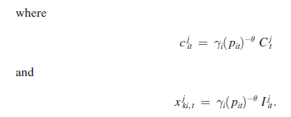
C. Market Clearing
The world resource constraint

Slide 16
D. Equilibrium
Assumption 1: Unitary elasticity of substitution of intermediate goods (θ = 1).
Assumption 2: Consumers have logarithmic preferences ( ρ = 1).
Assumption 3: The capital-adjustment technology is log-linear, as in equation (3).

Slide 17
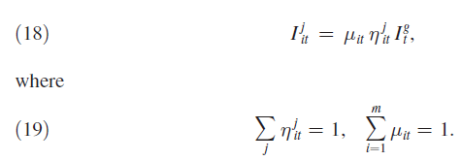
D. Equilibrium
Optimal consumption of a young consumer in j
Global investment-output ratio is a constant
Investment in any sector i, in any country j

Slide 18
D. Equilibrium
Lemma 1: The share of global investment allocated to industry i, μ it , is a constant where
The greater the “weighted capital share” for industry i relative to the weighted average capital share, the larger the share of global investment apportioned to industry i.

Slide 19
D. Equilibrium
Convergence and Composition Effect:
The country-share of global investment in any industry i

Slide 20
D. Equilibrium

Slide 21
III. The Composition Effect

Slide 22
Assumption IV: The most labor-intensive sector uses only labor as an input and no capital in the production technology, i.e., α₁ = 0.
Effective capital-labor ratio in sector I
Labor reallocation across sectors alone is sufficient to equalize sector-level capital effective-labor ratios, across countries.
Thus, convergence effect is totally removed

Slide 23
Proposition 1
Proposition 1: With Assumptions 1−4, the share of Home’s investment in any industry i, η it , is a constant and is equal to its initial share of world capital stock in that sector

Slide 24
Proposition 1
A positive labor force/productivity shock => increase world output => increase proportionate investment => capital flows to countries with higher initial weighted-average capital share

Slide 25
A. Aggregate Savings and Investment
Country j’s labor income-GDP ratio can then be expressed as (a negative function of κ)
Country j’s saving to GDP ratio (a negative function of κ)
A fall in κ causes j to specialize in labor-intensive goods

Slide 26
A. Aggregate Savings and Investment
Country j’s investment to GDP ratio (a positive function of κ)

Slide 27
A. Aggregate Savings and Investment
Reduction in Kappa =>
Net capital outflow

Slide 28
A. Aggregate Savings and Investment
Reduction in Kappa =>
Net capital inflow

Slide 29
B. International Capital Flows
Proposition 2 (Globalization): Suppose that all countries are initially in autarky prior to period t, and unexpectedly open up to trade and capital flows at t. Then,
Proposition 3 (Labor Force/Productivity Shock): Suppose that all countries are
open at t. A high or in country j causes a net capital outflow in j, at t.

Slide 30
B. International Capital Flows
Proposition 4 (Path Dependence): The evolution of the depends on j’s initial weighted-average share of capital stock in the world, : the higher the initial weighted-average share of capital in j, the higher the effective capital-labor ratio in j at every point on the transitional path.

Slide 31
IV. Quantitative Analysis

Slide 32
A. A Multi-period OLG Model
Extend analytical two-period OLG framework to a multi-period setting
Allowing for non-tradable sectors
Two important global events:
Integration of China, India, and the ex-Soviet bloc into the world economy in the beginning of the 1990s
Developing countries as a whole have experienced a rapid increase in the labor force over the period 1990–2010 (working population growth + productivity growth)

Slide 33
B. Calibration

Slide 34
C. Results
Scenario 1 (Integration of China, India, and the ex-Soviet Bloc):
Initially in their autarkic steady states (low TFP, low K/L ratio)
Price of good 1 (labor intensive good) in E-regions increases
Price of good 2 (capital intensive good) in E-regions decreases
E-region runs a large initial CA surplus upon the shock
Incorporation of non-tradable sector reduces the impact, quantitatively but not qualitatively.

Slide 35
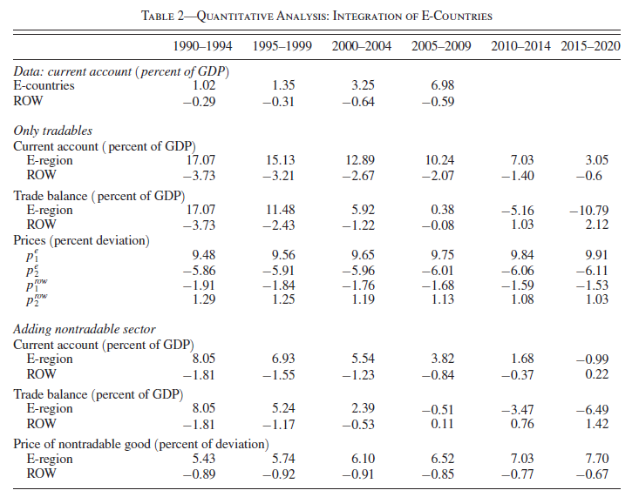

Slide 36
C. Results
Scenario 2 (Effective Labor Force Growth in Developing Countries):
Developing countries run an initial small CA deficit, followed by surplus in all remaining periods
Compare with one-sector model (large CA deficit in every period, large inflow of capital to developing countries) – only convergence effect

Slide 37
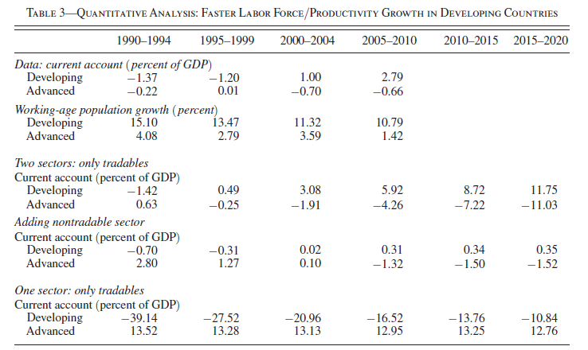

Slide 38
D. Discussion
Extend to infinite-horizon models
Specialization patterns at the time of the shock are identical
Composition effect: the rise in demand for capital in the country that has shifted its production towards more capital-intensive secters
Aggregate savings rises
Increases the amount of capital that could be released to abroad (actual flow will be based on constraints)

Slide 39
D. Discussion
Strength of the Composition Effect
The composition effect is strong when specialization patterns are pronounced, factor intensity difference is obvious
Limitation of composition effect: when factor intensities converges to the same level

Slide 40
V. Suggestive Empirical Evidences

Slide 41
Main Purpose
To provide some suggestive evidence for the main prediction of the theory:
Whether countries which have become more specialized in capital intensive goods have also run greater current account deficits
Whether changes in the relative prices of capital and labor intensive goods are consistent with the theory
First document facts on the trading patterns and the current account dynamics across countries over the last two decades
Then proceeds to investigate the main prediction

Slide 42
The Methodology
Constructing time-varying specialization patterns for each country, based on the notion of “Revealed Comparative Advantage’’
Using these specialization patterns to detect whether changes in these patterns are correlated with current account movements in a way that is consistent with the theory

Slide 43
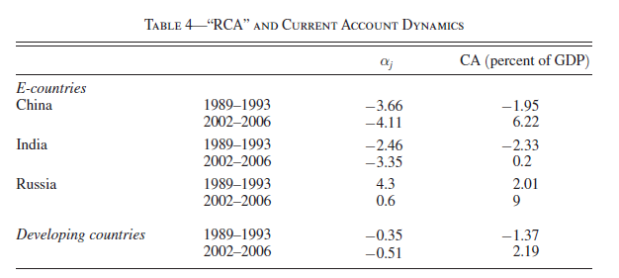
Results
Patterns of “Revealed Comparative Advantage’’ and the Current Account
Increase in capital intensity reduces alpha for developing countries

Slide 44
Results
Patterns of “Revealed Comparative Advantage’’ and the Current Account
Relationship between alpha and current account
The central theoretical prediction is that countries with become more specialized in capital-intensive industries over time run greater current account deficits.

Slide 45
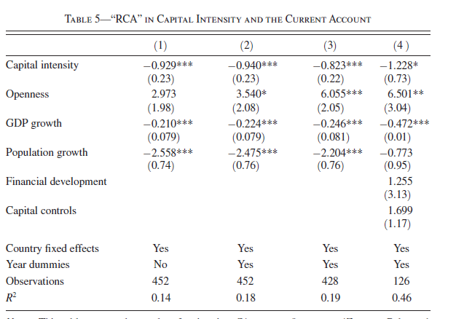

Slide 46
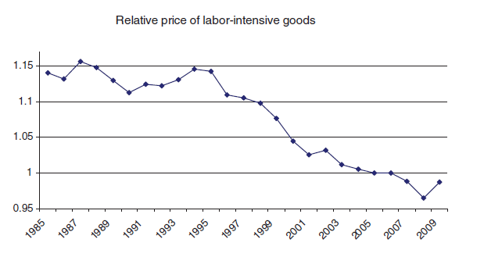
Results
Relative Prices
Fall in price of labor-intensive goods, met by data

Slide 47
VI. Final Remarks

Slide 48
Final Remarks
International commodity trade and financial capital flow – A Multi-sector Model
Capital-Intensity of a country’s export and production structure affects its demand for financial capital
Financial capital inflows into a country can affect its degree of specialization in capital-intensive industries

Slide 49
Final Remarks
Composition effect: capital tends to flow toward countries that become more specialized in capital-intensive sectors
Convergence effect: capital tend to flow toward where capital is scarcer

Slide 50
Final Remarks
Globalization or faster labor force/productivity growth can lead to capital flows away
Sharp contrast with the standard one sector model, but is consistent with data

Slide 51
Thank You!

